Slide 1
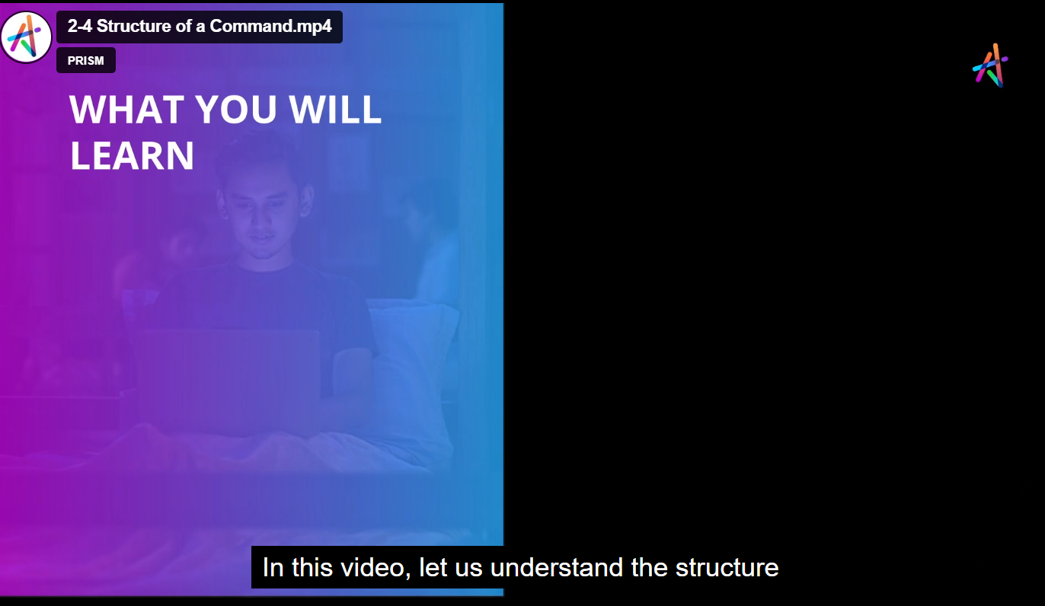

WHAT YOU WILL
LEARN
Kubernetes & Docker:
The Complete Hands-on Guide

Slide 2
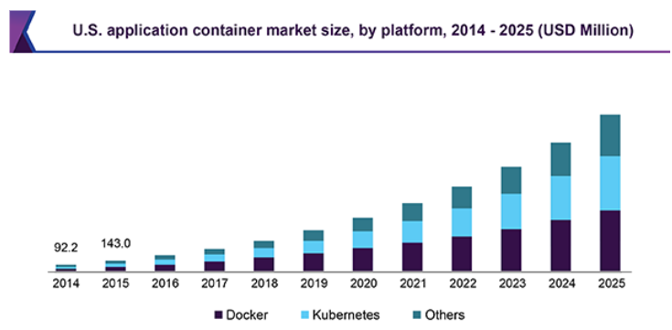
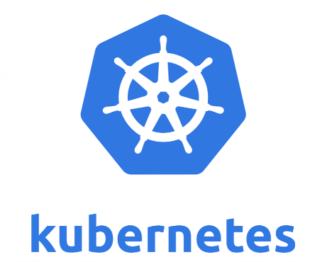
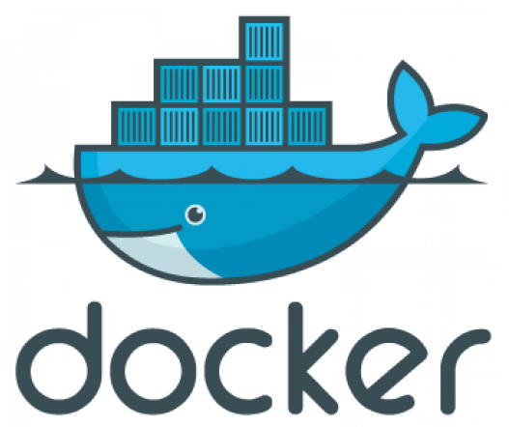
Kubernetes & Docker: The Complete Hands-on Guide
It is an open-source system for automating deployment, scaling, and management of containerized applications.

Slide 3

About Instructor
IT Industry Experience – 15 Years
Passion – Online Job Oriented Certified Courses
Teaching Over to 75000 Students
Shikhar Verma

Slide 4
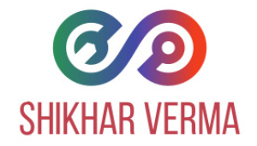
Prerequisites
PC or Laptop with internet Connection
Must have one AWS Free Tier Account
Motivation to Learn Docker, Kubernetes, DevOps

Slide 5
What is Kubernetes? Open source container orchestration tool, developed by Google. It is used for automating deployment, scaling, and management of containerized applications.
Why do we use Kubernetes? For production ready deployment of Micro-services and small apps. Having less failure and downtimes. Backup & restores. Kubernetes services provide load balancing and simplify container management on multiple hosts. In fact, Kubernetes is the fastest growing project in the history of open-source software, after Linux.

Slide 6
What is Kubernetes? Open source container orchestration tool, developed by Google. It is used for automating deployment, scaling, and management of containerized applications.
Why do we use Kubernetes? For production ready deployment of Micro-services and small apps. Having less failure and downtimes. Backup & restores. Kubernetes services provide load balancing and simplify container management on multiple hosts. In fact, Kubernetes is the fastest growing project in the history of open-source software, after Linux.

Slide 7
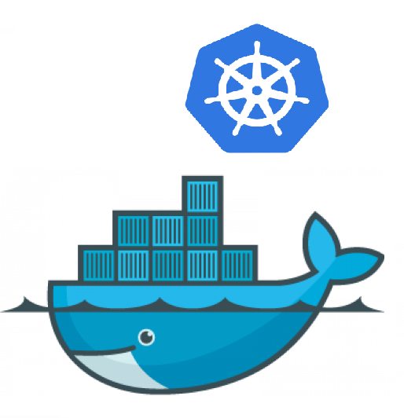

Slide 9
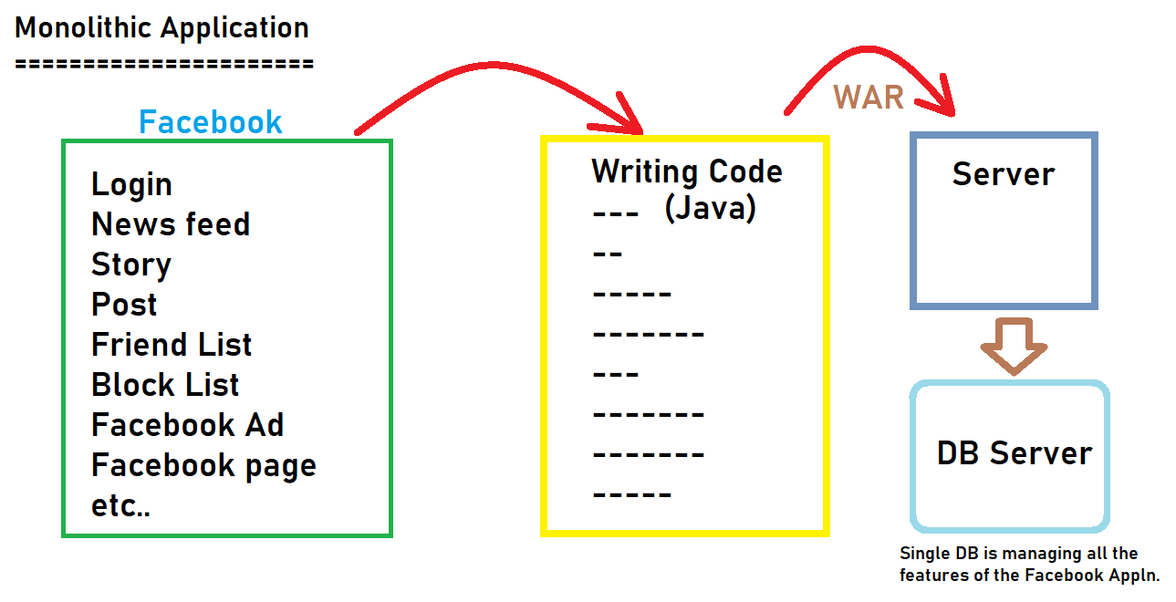

Slide 10
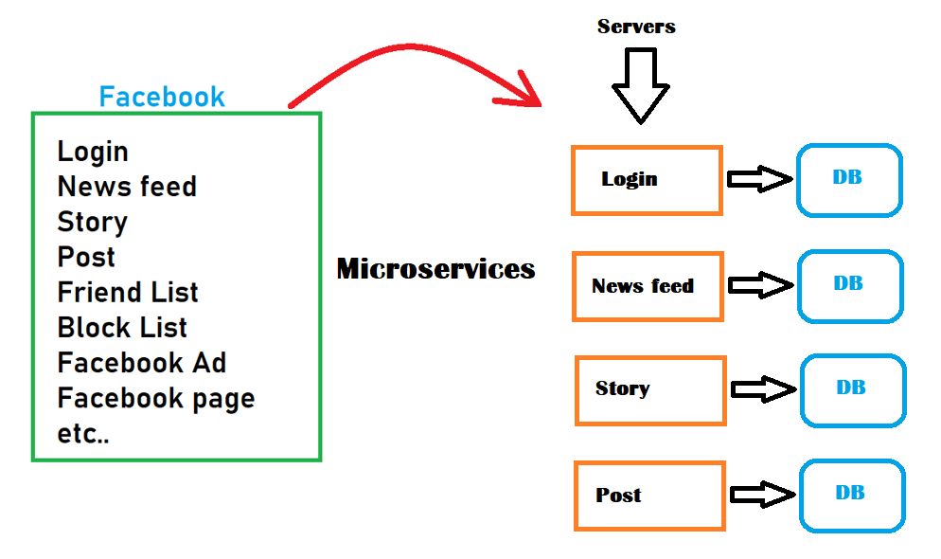

Slide 12
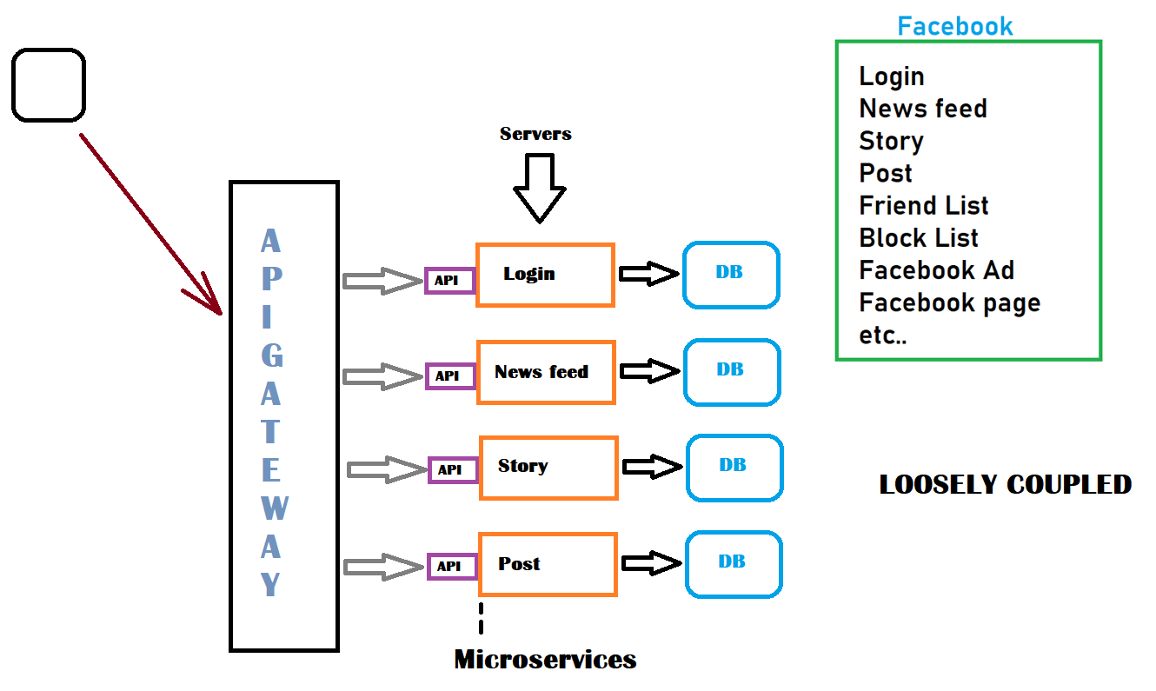

Slide 13
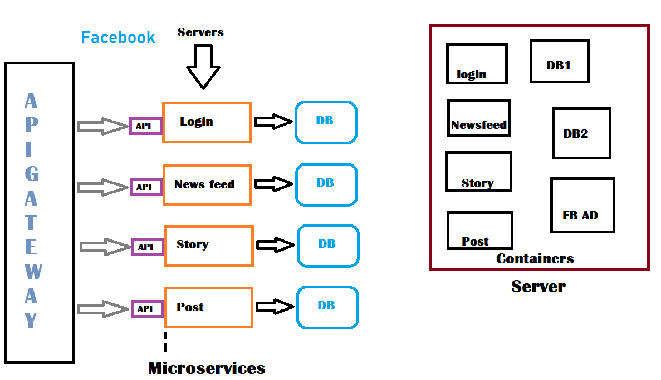

Slide 14
What is Kubernetes? Open source container orchestration tool or container management tool, which automates Container Deployment, Container Scaling & Load Balancing.
It schedules, runs and manages isolated containers which are running on Virtual/Physical/Cloud Machines.
All top cloud providers support Kubernetes.

Slide 15
In 2014, Google introduced Kubernetes as an open source platform written in ‘Golang’ and later donated to CNCF (Cloud Native Computing Foundation).
Online Platform For Kubernetes
Kubernetes playground
Play with K8s
Play with Kubernetes Classroom
Cloud Based K8s Services
GKE – Google Kubernetes Service
AKS – Azure Kubernetes Service
Amazon EKS – Elastic Kubernetes Service
Kubernetes Installation Tool
Minicube
Kubeadm

Slide 16
Issues with Containers (Without Kubernetes)
Containers can’t communicate to each other.
Auto Scaling and Load Balancing was not possible with containers.
Containers had to be managed carefully.

Slide 17
Features of Kubernetes
Orchestration (Clustering of any number of containers running on different n/w).
Auto scaling (Vertical/Horizontal)
Load Balancing
Auto-healing
Platform Independent (Cloud/Virtual/Physical)
Fault tolerance (Node/POD failure)
Rollback (Going back to previous version)
Health monitoring of containers
Batch execution (one time, sequential, parallel)

Slide 18
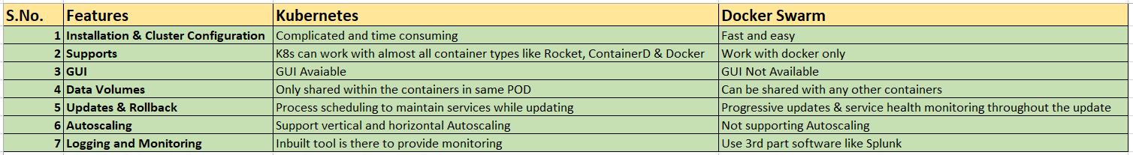

Slide 19
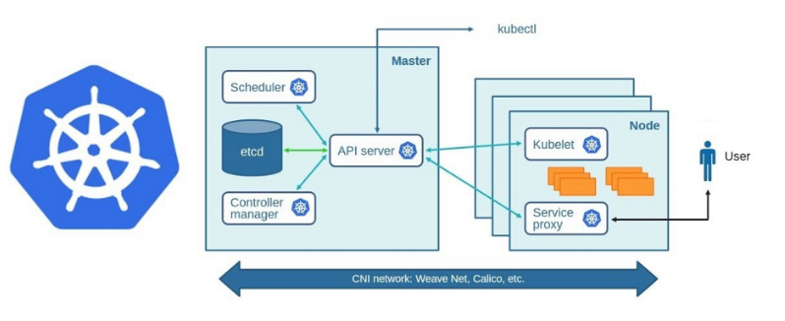
Architecture

Slide 20
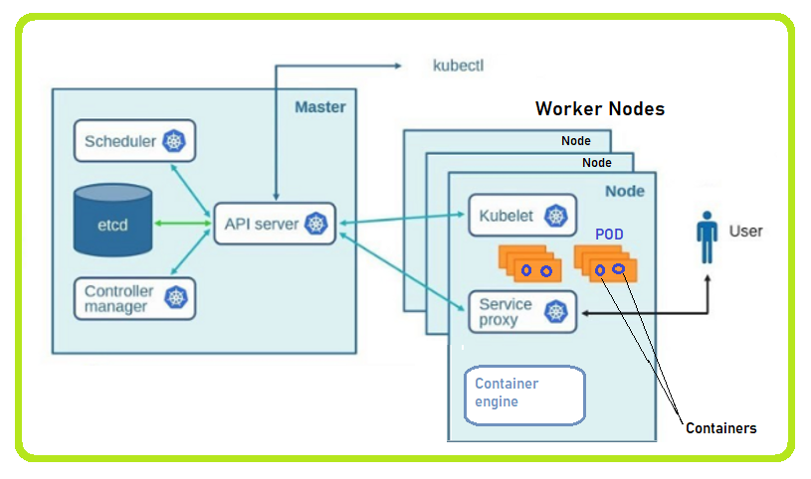
Architecture

Slide 21
Working with Kubernetes
We create a manifest either using YAML or JSON.
Apply this to the master cluster node to bring it into the desired state.
POD always runs on the node, which is controlled by the master.

Slide 22
Roles of Master Node
In the Kubernetes cluster, the containers can be run on bare metal ( on-premises), VM instances, and cloud environments..
In Kubernetes clusters, it can have one or more master nodes and also one or more worker nodes, it depends upon how you design your Kubernetes cluster.
The master node runs a set of K8s processes. These processes will ensure the smooth functioning of the cluster, and these processes are called the "control plane."
It can be multi-master for high availability.

Slide 23
Components of Control Plane (Master)
API server
Etcd
Scheduler
Controller manager

Slide 24
API server
The API server interacts directly with the user (i.e., we apply .yml or json manifest) to API server.
The API server is meant to scale automatically as needed.
The API server is the front-end of the control plane.

Slide 25
etcd
Stores metadata (data about data) and the status of the cluster.
etcd is consistent and high-availablility.
It stores data in key-value format such as; Name = Shikhar or Age = 35.
etcd has following features
Fully replicated - The entire state is available on every node in the cluster.
Secure - Implements automatic TLS with optional client-certificate authentication.
Fast - Benchmarked at 10,000 writes per second.

Slide 26
Scheduler (Action)
When users make requests for the creation & management of PODs, Kube-Scheduler is going to take action on these requests and handle pod creation and management.
Kube-scheduler matches or assigns any node to create and run pods.
A scheduler is responsible for finding the best node for the newly created pods if the node is not assigned while creating the pod.
The scheduler gets the information for hardware configuration from configuration files and schedules the pods on nodes accordingly.

Slide 27
Controller manager
Actual state = desired state It makes sure the actual state of the cluster matches the desired state.
Two possible choices for controller manager. 1. If K8s is on the cloud, then it will be a cloud-controller manager. 2. If K8s is on non-cloud, then it will be kube-controller-manager.

Slide 28
Worker node ( Kubelet, Kube proxy & Container engine ) Node is going to run 3 important pieces of software/processes.
Kubelet
Agent runs on every node.
Listens to Kubernetes master ( eg - pod creation request).
Use port 10255.
Send success/fail reports to master.

Slide 29
Container Engine (Docker)
Works with kubelet.
Pulling images.
Start/stop containers.
Exposing containers on ports specified in the manifest.

Slide 30
Kube-Proxy
Assign IP to each Pod.
It is required to assign IP addresses to PODs (dynamic).
Kube-proxy runs on each node and makes sure that each Pod will get its own unique IP address.

Slide 31
POD
It is the smallest unit in Kubernetes.
POD is a group of one or more containers that are deployed together on the same host.
A Kubernetes cluster has at least one worker node and one master node.
In Kubernetes, the control unit is the POD, not the containers.
There could be one or more containers in a POD that is tightly coupled.
POD always runs on the node, which is controlled by the master and containers can’t be started without the POD.
One POD usually (in ideal condition) contains one container only.

Slide 32
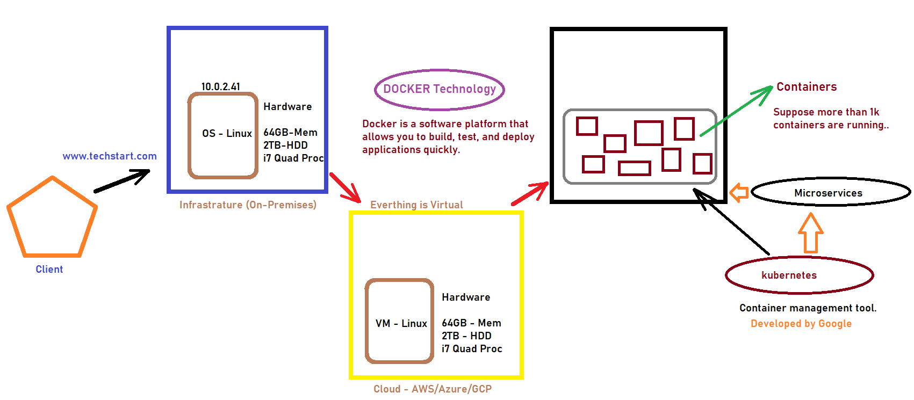

Slide 33
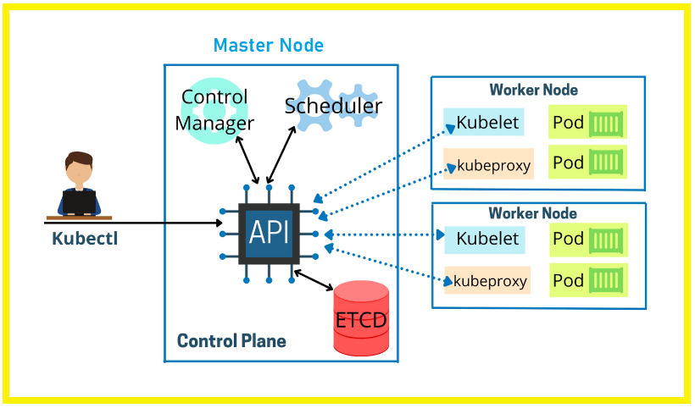
Setup Kubernetes Master and Worker Node on AWS

Slide 34
Types of Kubernetes Cluster
All-in-one (Single Node Cluster).
Single-Node etcd, Single-master and Multi-worker Node Cluster.
Single-Node etcd, Multi-master and Multi-worker Node Cluster.

Slide 35
Minikube – It is a tool that lets you run Kubernetes locally. minikube runs an all-in-one or a multi-node local Kubernetes cluster on your personal computer (including Windows, macOS and Linux PCs) so that you can try out Kubernetes, or for daily development work.

Slide 36
Kubernetes annotations are the second way of attaching metadata to the Kubernetes resources.

Slide 37
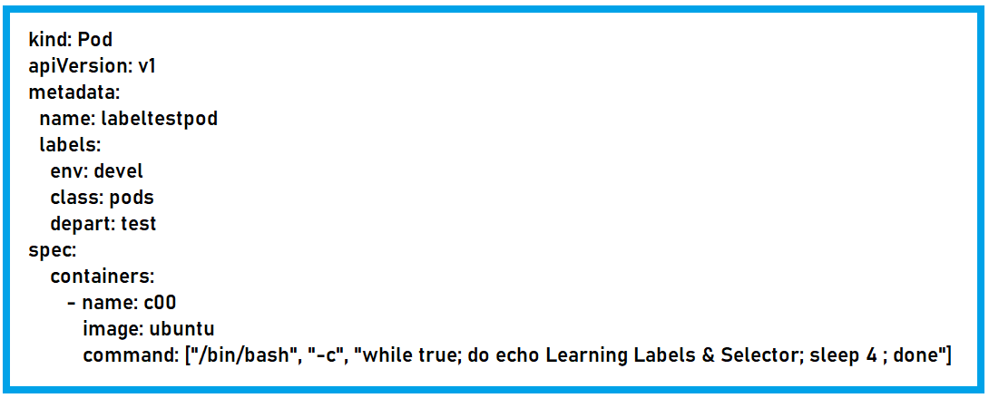
Labels and Selectors
Labels are key/value pairs that are attached to objects, such as pods.
Labels are the mechanism, which can be used to organize Kubernetes objects.
Labels are similar to tags in AWS or git.

Slide 38
Labels and Selectors
kubectl apply -f <pod.yml>
kubectl get pods --show-labels
kubectl label pods labeltestpod Company=Techstart
kubectl get pods --show-labels
Now, list pods matching a label
kubectl get pods -l env=develop
kubectl get pods -l env!=develop
kubectl delete pod -l env!=develop
kubectl get pods

Slide 39
Labels and Selectors
Once labels are attached to an object, we would need filters to narrow down and these are called as Label selectors.
The Api currently supports two types of Selectors - Equality Bsaed and Set Based.
Equality Based: ( =, !=)
Set Based: ( in, notin and exists) env in (production, dev) env notin ( class1, class2)
For Examples:
kubectl get pods -l 'env in (dev, testing)'
kubectl get pods -l 'env notin (dev, testing)'
kubectl get pods -l class=pods, Company=Techstart

Slide 40
Node Selectors
Node Selector is used to specify the nodes into which a POD can be scheduled. i.e. You can tell a pod to run on a particular node.
Generally, such constraints are unnecessary, as the scheduler will automatically do a reasonable placement, but in certain circumstances, we might need it.
We can use labels to tag nodes as well.
When the nodes are tagged, you can use the label selectors to specify the pods to run only on specific nodes.
First, we will assign labels to the nodes.
Then use the node selector for the pod configuration.

Slide 41
ReplicationController
A ReplicationController is a object that enables you to easily create multiple PODs.
A ReplicationController ensures that a specified number of pod replicas are running at any one time. In other words, a ReplicationController makes sure that a pod or a homogeneous set of pods is always up and available.
If a POD is created using the ReplicationController and if in case, it crashes, fails, or terminated, then your replication controller will recreate a new one.
ReplicationController is recommended, if you just want to make sure at least one POD is always running, even after the system reboots.

Slide 42
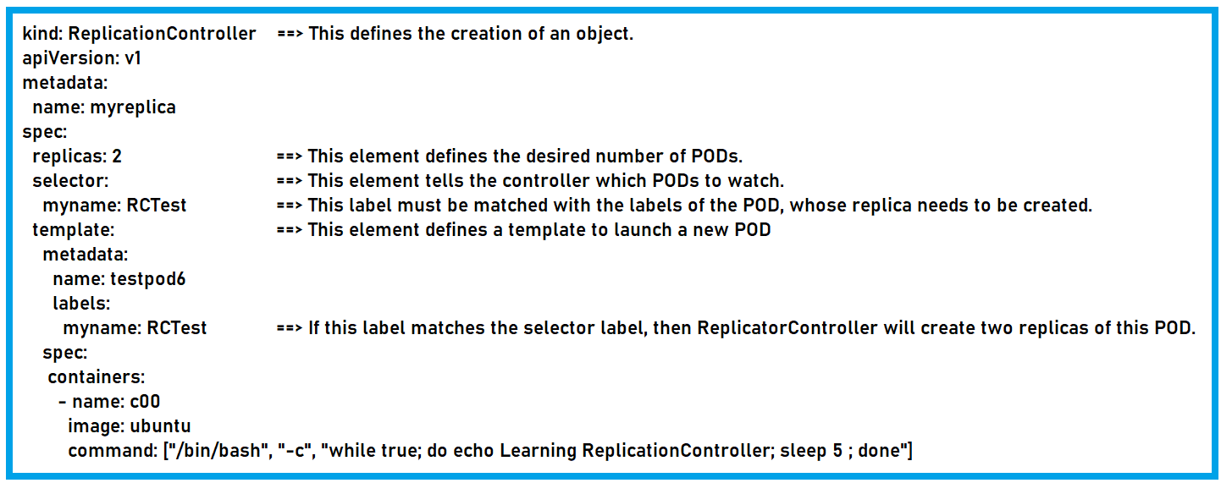

Slide 43
ReplicaSet
A ReplicaSet's purpose is to maintain a stable set of replica pods running at any given time. As such, it is often used to guarantee the availability of a specified number of identical pods.
ReplicaSet is the next generation of ReplicationController.
The ReplicationController only supports equality-based selectors, whereas, the ReplicaSet supports set-based selectors, i.e., filtering according to a set of values.

Slide 44
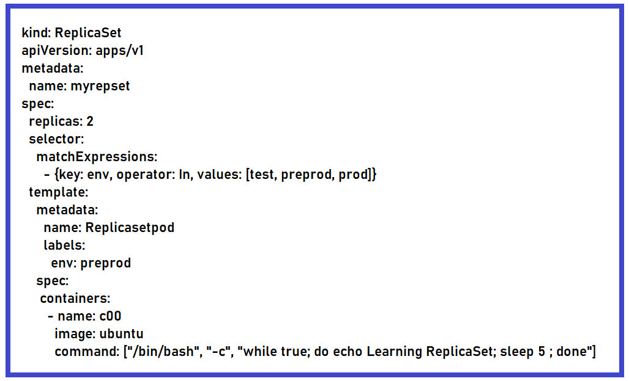

Slide 45
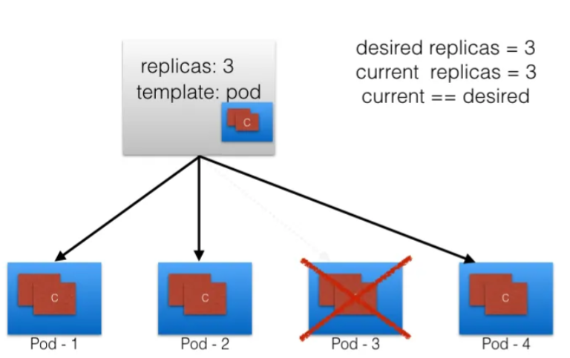
Scaling & Replication

Slide 46
Deployment & Rollback
A ReplicaSet's purpose is to maintain a stable set of replica pods running at any given time. As such, it is often used to guarantee the availability of a specified number of identical pods.
ReplicaSet is the next generation of ReplicationController.
The ReplicationController only supports equality-based selectors, whereas, the ReplicaSet supports set-based selectors, i.e., filtering according to a set of values.

Slide 47
Deployment & Rollback
ReplicationController & ReplicaSet are not able to update & rollback apps in the cluster.
A deployment object act as a supervisor for PODs, giving you fine-grained control over how and when a new pod is rolled out, updated, or rolled back to the previous state.
When using the deployment object, we first define the state of the app, then the K8s cluster schedules mentioned app instances onto specified individual nodes.
K8s then monitors, if the node hosting an instance goes down or the pod is deleted, and the deployment controller replaces it.
This provides a self-healing mechanism to address machine failure or maintenance.

Slide 48
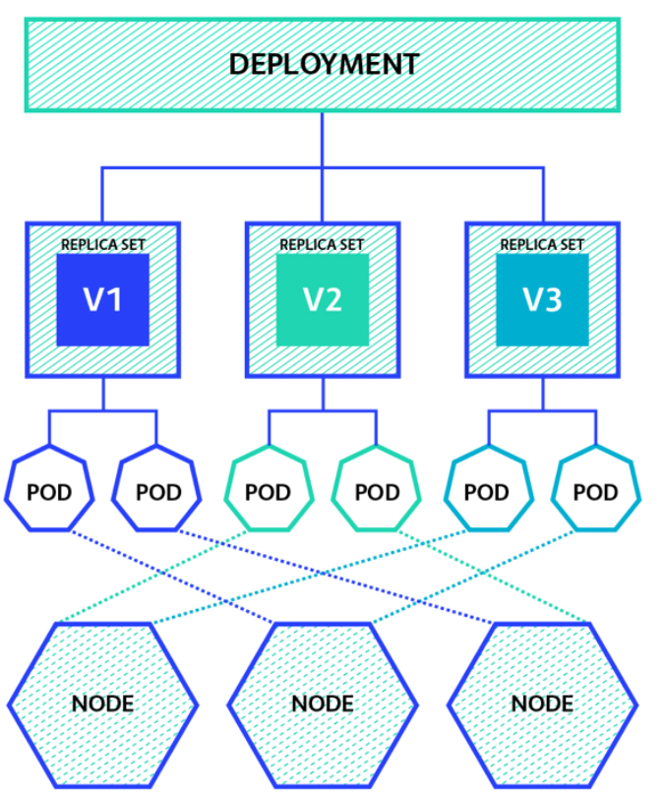

Slide 49
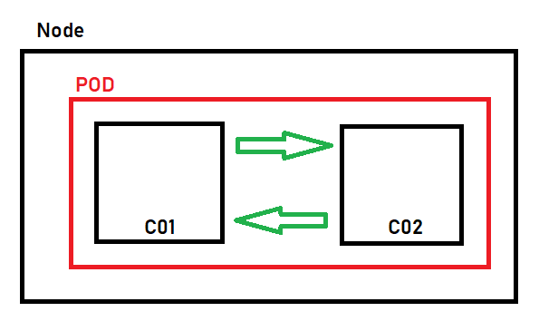
Kubernetes Networking
Containers within a POD can communicate to each other via local host.

Slide 50
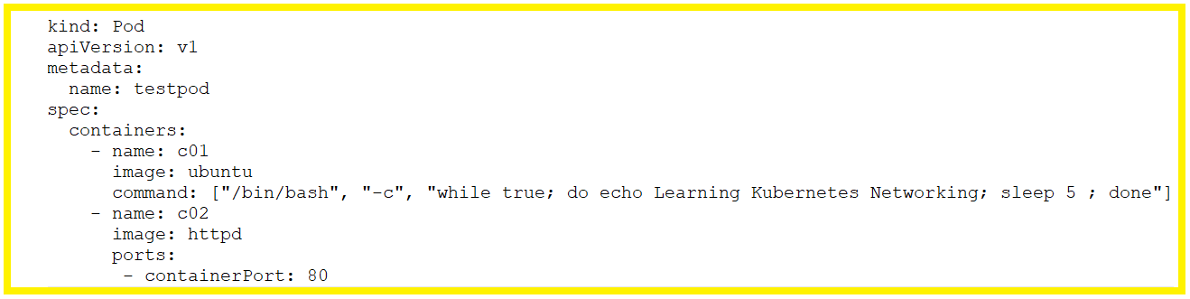
Kubernetes Networking
Containers within a POD can communicate to each other via local host.

Slide 51
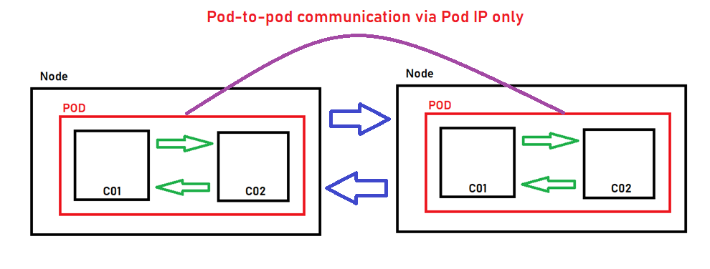
Kubernetes Networking
Pod-to-pod communication on the same worker node happens via POD IP.
By default, POD’s IP is not able to access from outside the node.

Slide 52
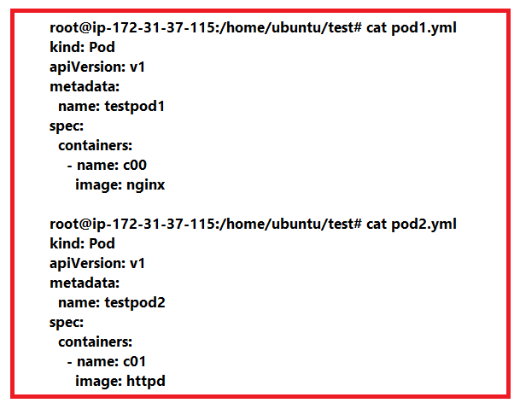
Kubernetes Networking

Slide 53
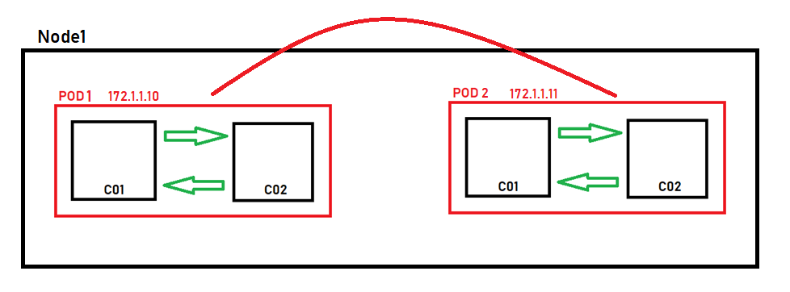
Object - Service
Each pod gets its own IP address, however, in a deployment, the set of pods running at one moment in time could be different from the set of pods running that application a moment later.
This leads to a problem, if some set of Pods ( call them backend) provides functionality to other pods (call them frontend) inside your cluster, how does the frontend find outs and keep track of which IP address to connect to, so that the frontend can use the backend part of the workload.

Slide 54
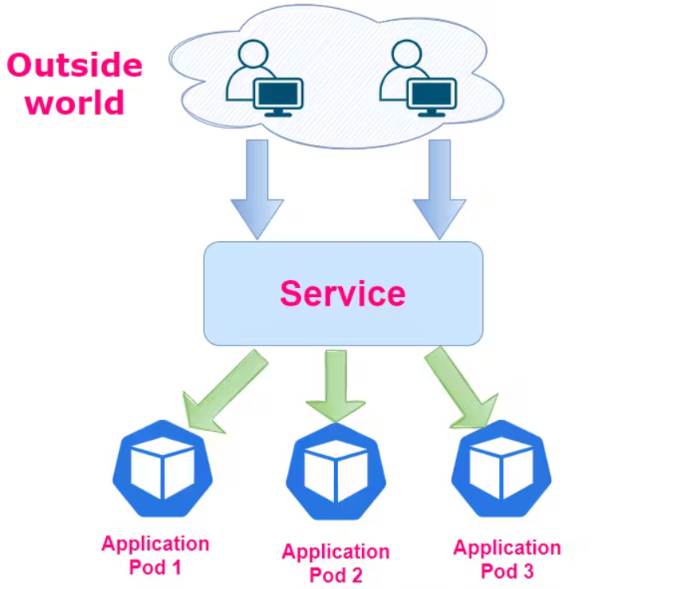
Object - Service
It enables communication between various components within and outside of the application. It provides us a single and stable IP address and DNS name through which we can access underlying application pods.

Slide 55
Why Service is required?
Pods are nonpermanent resources. Whenever pods fail they get replaced by new ones with the new IPs. Scaling-up operation also introduces new Pods with new IP addresses. Scaling down operation removes Pods. Rolling updates too replaces existing Pods with new ones with new IPs.

Slide 56
Volumes
Containers are short-lived in nature.
All data stored inside a container is deleted if the container crashes, deleted or terminated.
The Kubelet will recreate a new pod with a "clean state," which does not have any previous data.
To overcome this problem, Kubernetes uses volumes. A volume is essentially a directory backed by a storage medium. The storage medium and its components are determined by the volume types.
In Kubernetes, a volume is attached to a pod and shared among the containers in the pod.

Slide 57
Volumes
A volume type decides the properties of the directory, like the size, content, etc.
A few examples of volume type are as follows:
Node-local types such as emptydir and hostpath.
File sharing types such as nfs.
Cloud provider-specific types like awselasticblockstore, azuredisk.
Distributed file systems like Glusterfs or cephfs.

Slide 58
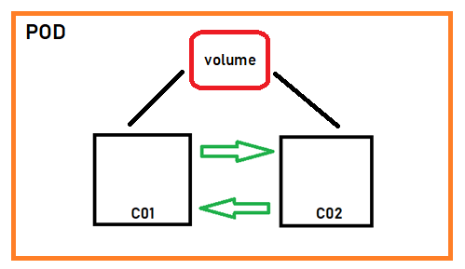
EmptyDir
Use this type of volume when we need to share contents between multiple containers on the same pod or not with the host machine.
An emptydir volume is first created when a pod is assigned to a node, and it exists as long as the pod is running on the node.
As the name implies, it is initially empty.

Slide 59
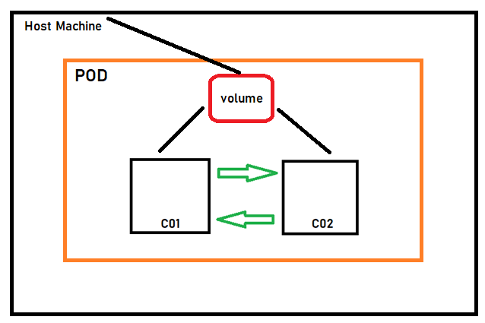
hostpath
We can use this type of volume, when it is required to access the container data from host machine as well.

Slide 60
Persistent Volume
EmptyDir
Use this type of volume when we need to share contents between multiple containers on the same pod or not with the host machine.
An emptydir volume is first created when a pod is assigned to a node, and it exists as long as the pod is running on the node.
As the name implies, it is initially empty.

Slide 61
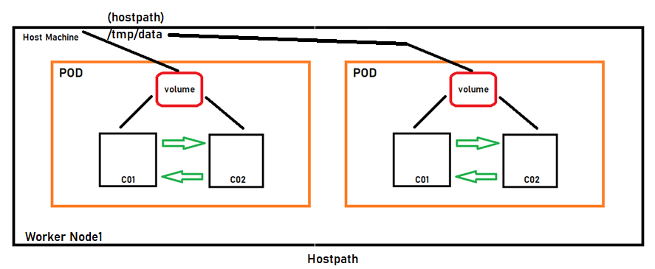
hostpath
We can use this type of volume, when it is required to access the container data from host machine as well.

Slide 62
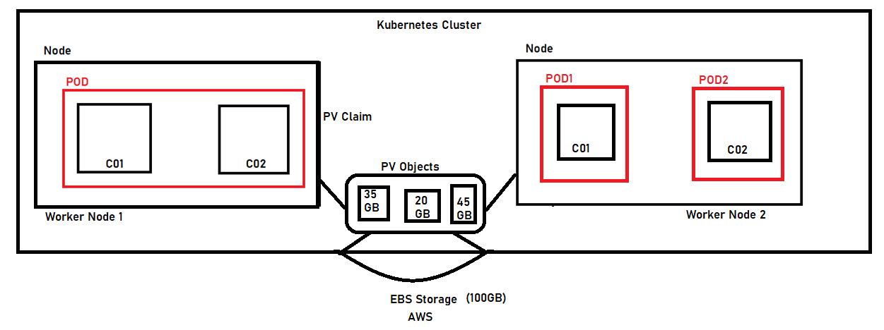
Persistent Volume
A persistent volume (PV) is a cluster-wide resource that you can use to store data in a way that it persists, even after the POD recreate with new one.

Slide 63
Namespaces
In Kubernetes, namespaces provide a mechanism for isolating groups of resources within a single cluster.
Names of resources need to be unique within a namespace, but not across namespaces.
Namespace-based scoping is applicable only for namespaced objects (e.g. Deployments, Services, etc) and not for cluster-wide objects (e.g. StorageClass, Nodes, PersistentVolumes, etc).
Namespaces are intended for use in environments with many users spread across multiple teams, or projects. For clusters with a few to tens of users, you should not need to create or think about namespaces at all. Start using namespaces when you need the features they provide.
By default, a Kubernetes cluster has a default namespace when provisioning the cluster to hold the default set of pods, services, and deployments used by the cluster.
We can use resource quotas to specify how many resources each namespace can use.

Slide 64
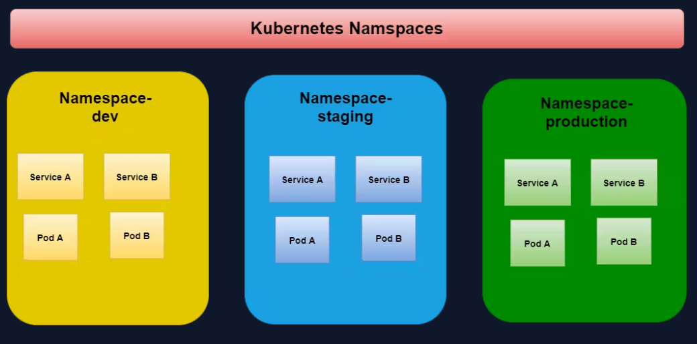
Namespaces

Slide 65
Namespaces
By default, a Kubernetes cluster having a default namespace when provisioning the cluster to hold the default set of pods, services, and deployments used by the cluster.
We can use resource quota on specifying how many resources each namespace can use.

Slide 66
Resource Management for Pods and Containers
A pod in Kubernetes will run with no limits on CPU or memory.
You can optionally specify how much CPU and memory (RAM) is needed for each container running in a pod.
The scheduler decides on which nodes to place pods only if the node has enough CPU resources available to satisfy the pod CPU request.
CPU is specified in units of cores, and memory is specified in units of bytes.
CPU values are specified in m(millicpu) and memory in MiB.
1 CPU = 1000m
0.5 CPU = 500m
0.1 CPU = 100m Here, “m” read as "one hundred millicpu". Some people say "one hundred millicores“.

Slide 67
Requests and Limits
Requests and limits are the mechanisms Kubernetes uses to control resources such as CPU and memory. Requests are what the container is guaranteed to get. If a container requests a resource, Kubernetes will only schedule it on a node that can give it that resource. Limits, on the other hand, make sure a container never goes above a certain value. The container is only allowed to go up to the limit, and then it is restricted.
It is important to remember that the limit can never be lower than the request. If you try this, Kubernetes will throw an error and won’t let you run the container.

Slide 68
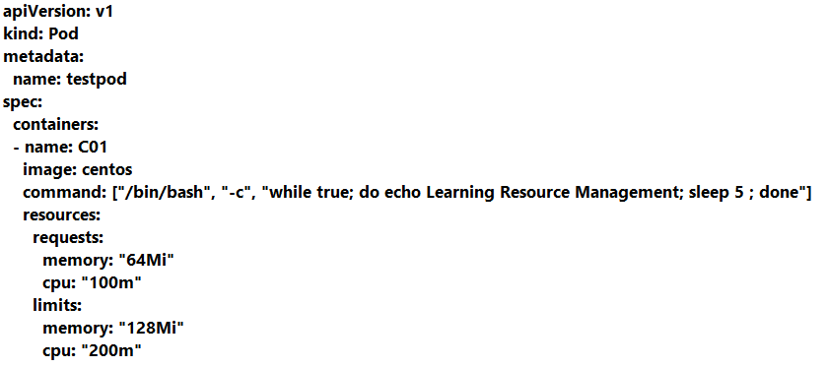
Requests and Limits

Slide 69
Requests and Limits

Slide 70
Horizontal Pod Autoscaler
HPA is a form of autoscaling that increases or decreases the number of pods in a replication controller, deployment, replica set, or stateful set based on CPU utilization—the scaling is horizontal because it affects the number of instances rather than the resources allocated to a single container.
HPA can make scaling decisions based on custom or externally provided metrics and works automatically after initial configuration. All you need to do is define the MIN and MAX number of replicas.
Once configured, the Horizontal Pod Autoscaler controller is in charge of checking the metrics and then scaling your replicas up or down accordingly. By default, HPA checks metrics every 15 seconds.
To check metrics, HPA depends on another Kubernetes resource known as the Metrics Server. The Metrics Server provides standard resource usage measurement data by capturing data from “kubernetes.summary_api” such as CPU and memory usage for nodes and pods.

Slide 71
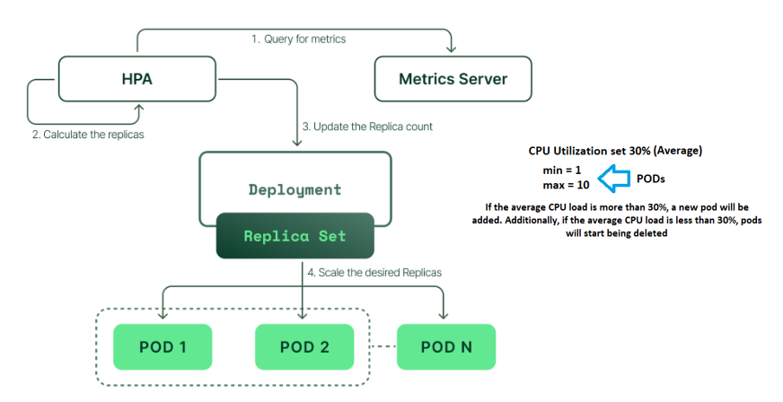
Horizontal Pod Autoscaler : Adjusts the number of replicas of an application.

Slide 72
Self-Healing pods in Kubernetes & their restart policies
Kubernetes provides this capability that can automatically restart containers whenever they fail. By the use of Restart Policies the user can customize this behavior by defining when the user want a pod’s containers to be automatically restarted.
There are three possible values for a pod’s restart policy in Kubernetes:
Always
OnFailure &
Never

Slide 73
Jobs
The main function of a job is to create one or more pod and tracks about the success of pods. They ensure that the specified number of pods are completed successfully. When a specified number of successful run of pods is completed, then the job is considered complete.
Use cases:
Take a backup of a database.
The Helm chart utilizes jobs.
Batch processes.
Schedule a task to run at intervals.
Perform log rotation.
Jobs do not get deleted by themselves, we have to delete them.

Slide 74
Cron Job Pattern
A CronJob creates Jobs on a repeating schedule.
CronJob is meant for performing regular scheduled actions such as backups, report generation, and so on. One CronJob object is like one line of a crontab (cron table) file on a Unix system. It runs a job periodically on a given schedule, written in Cron format.

Slide 75
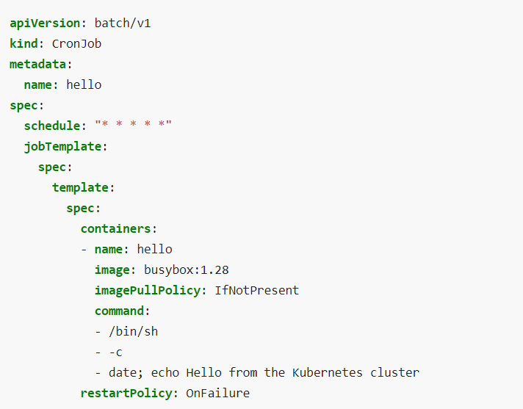
Cron Job Pattern

Slide 76
Init Containers
Init containers are specialized containers that run before application containers within a pod.
Init containers are always executed until completion.
If an init container in a pod fails, Kubernetes will continuously restart the pod until the init container succeeds.
Use cases
Seeding a database.
Delaying the application launch until the dependencies are ready.
Clone a git repository into a volume.
Generate configuration file dynamically.

Slide 77
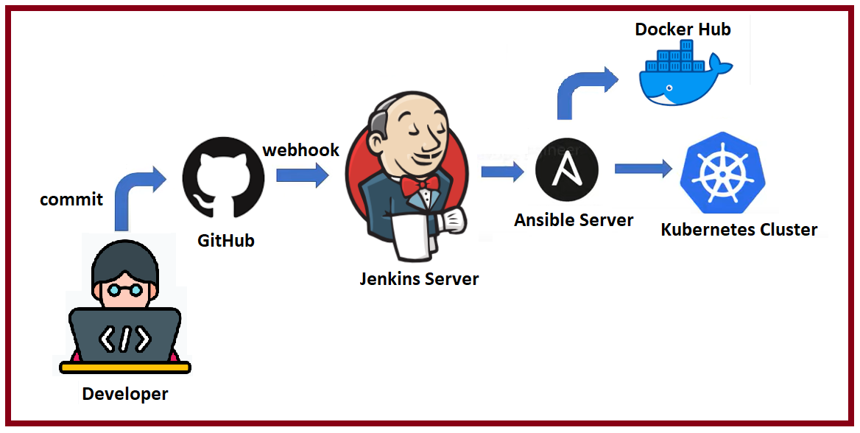
Real-time deployment on a Kubernetes cluster using Jenkins CI/CD

